Slide 1
MOD Spend Analysis
Prakash Hari Prasad

Slide 2
Table of Contents
Introduction and Overview
General Observations
Classifications
Expense Type
Spend Type and Supplier Type
Spend Analytics
All Transactions
Influenceable spend
Invoice Analysis
Supplier Analysis
Overview
Strategic Vendors
Expense Type Analysis
Risk and Risk Management in UK Defense(MOD)
Key Insights
Recommendations

Slide 3
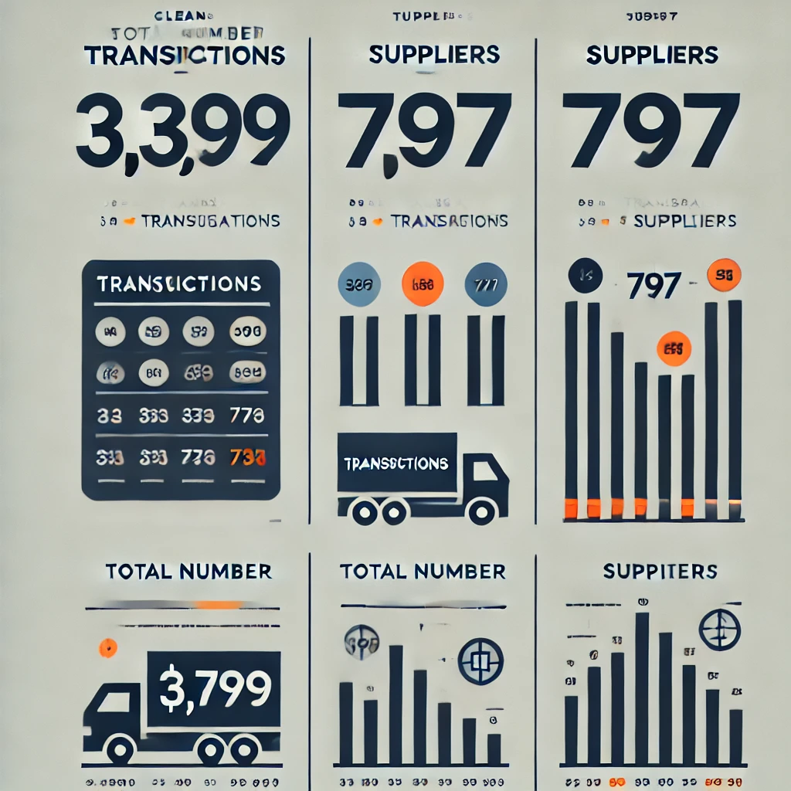
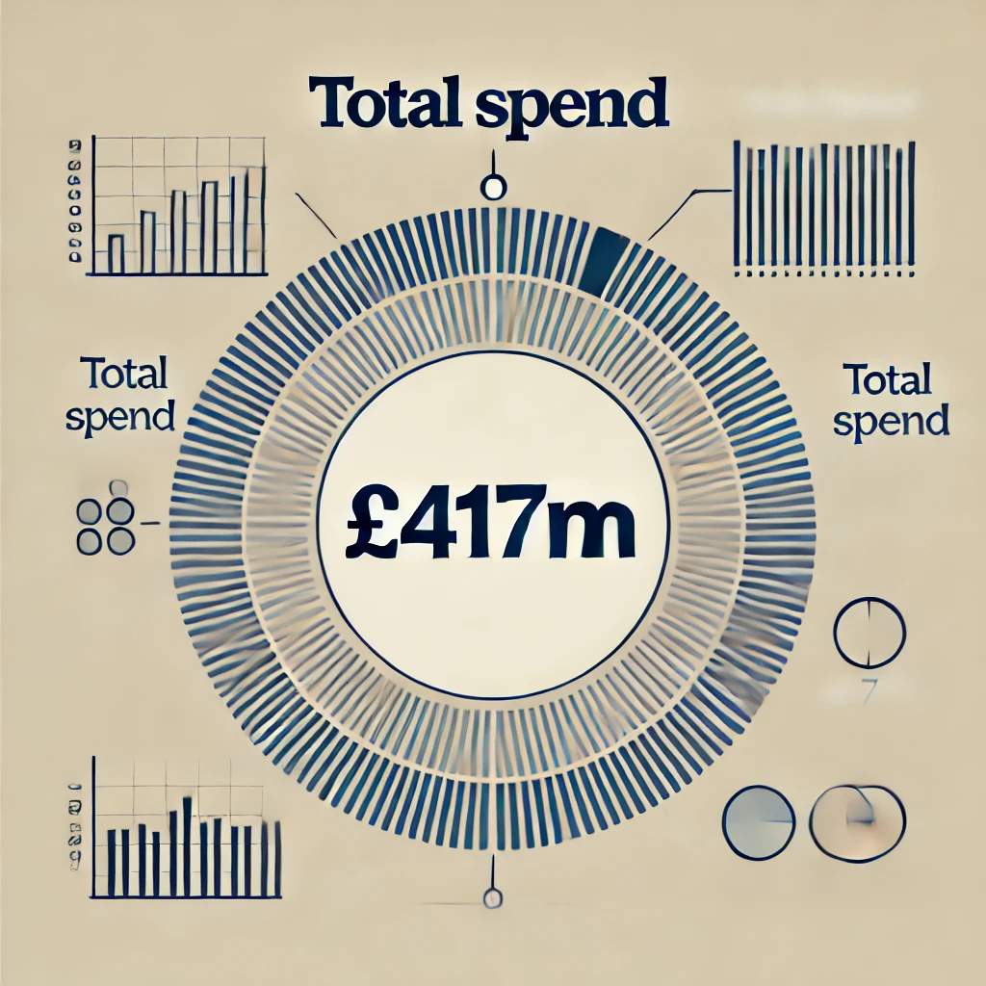
Introduction and Overview
This spend analysis reviewed the UK Ministry of Defence (MOD) expenditure data from January 20xx, with the aim to provide MOD with the following:
A user-friendly dashboard for visualizing spending and identifying potential savings.
Recommendations for process improvements.
Total spend is 417,271,495.91(GBP)
3399 Transactions and 797 Suppliers

Slide 4
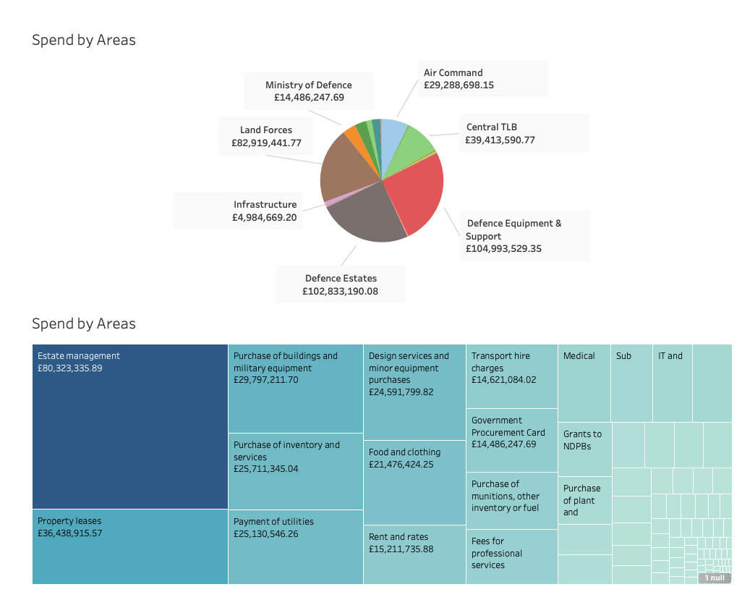
General Observations
1)This spend analysis reviewed the UK Ministry of Defence (MOD) expenditure data from January 20xx, with the aim to provide MOD with the following:
2)A user-friendly dashboard for visualizing spending and identifying potential savings.
3)Recommendations for process improvements.
4)Total spend is 417,271,495.91(GBP) ,3399 Transactions and 797 Suppliers

Slide 5
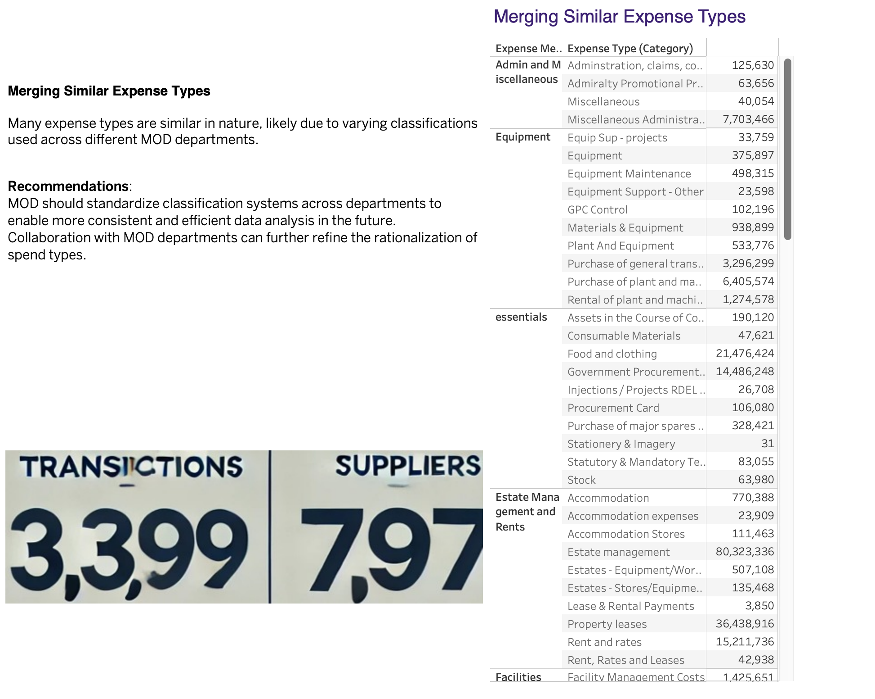
Classifications(Expense type)

Slide 6
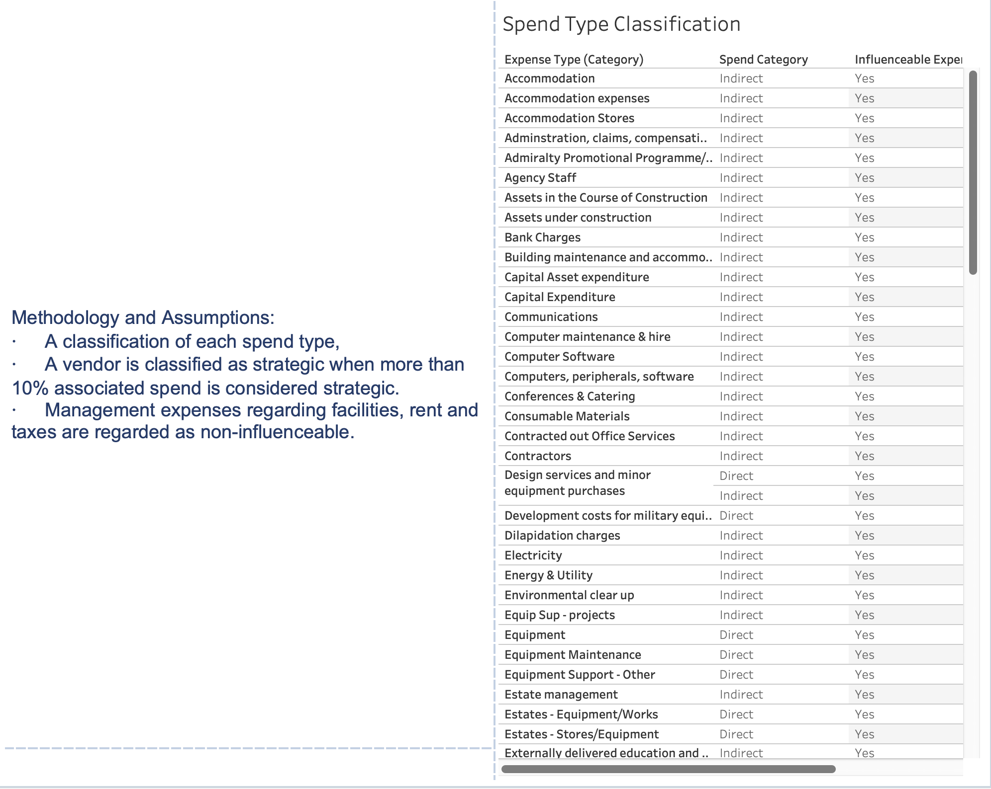
Classifications(Spend Type& Supplier Type)

Slide 7
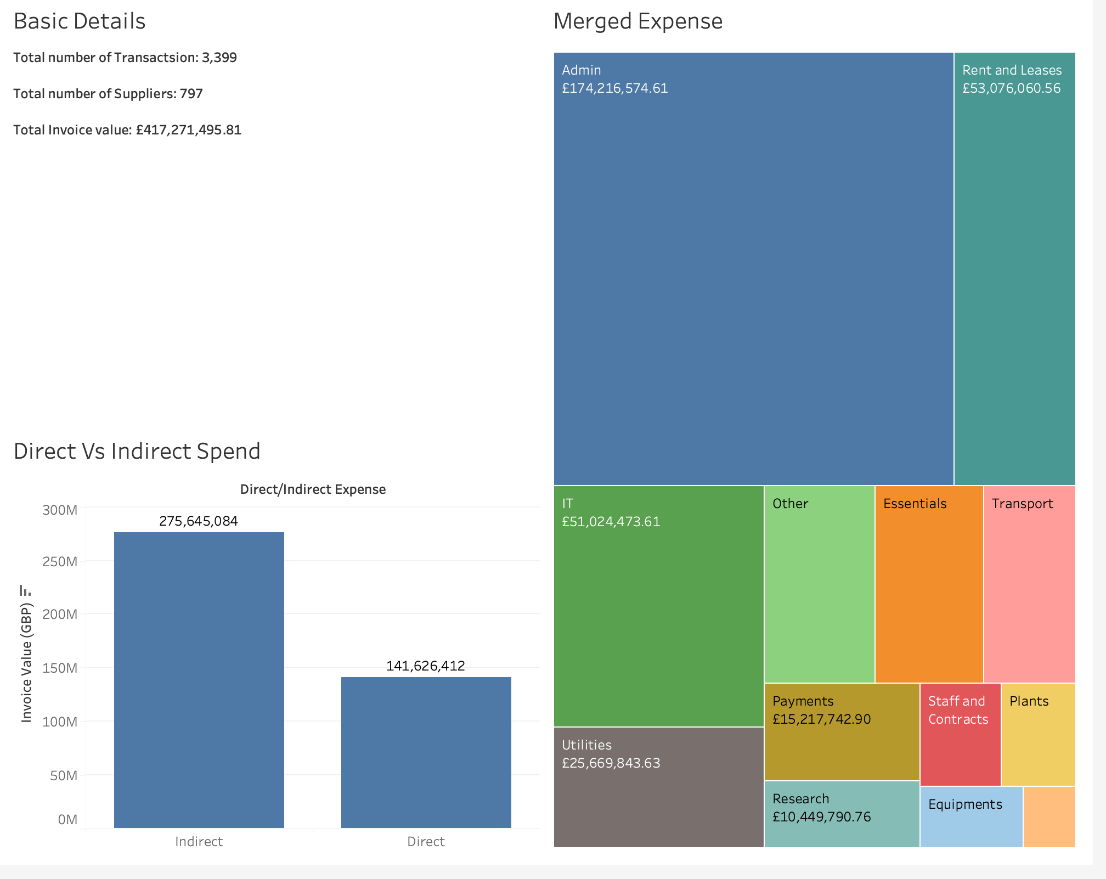
Spend Analytics (All transactions)

Slide 8
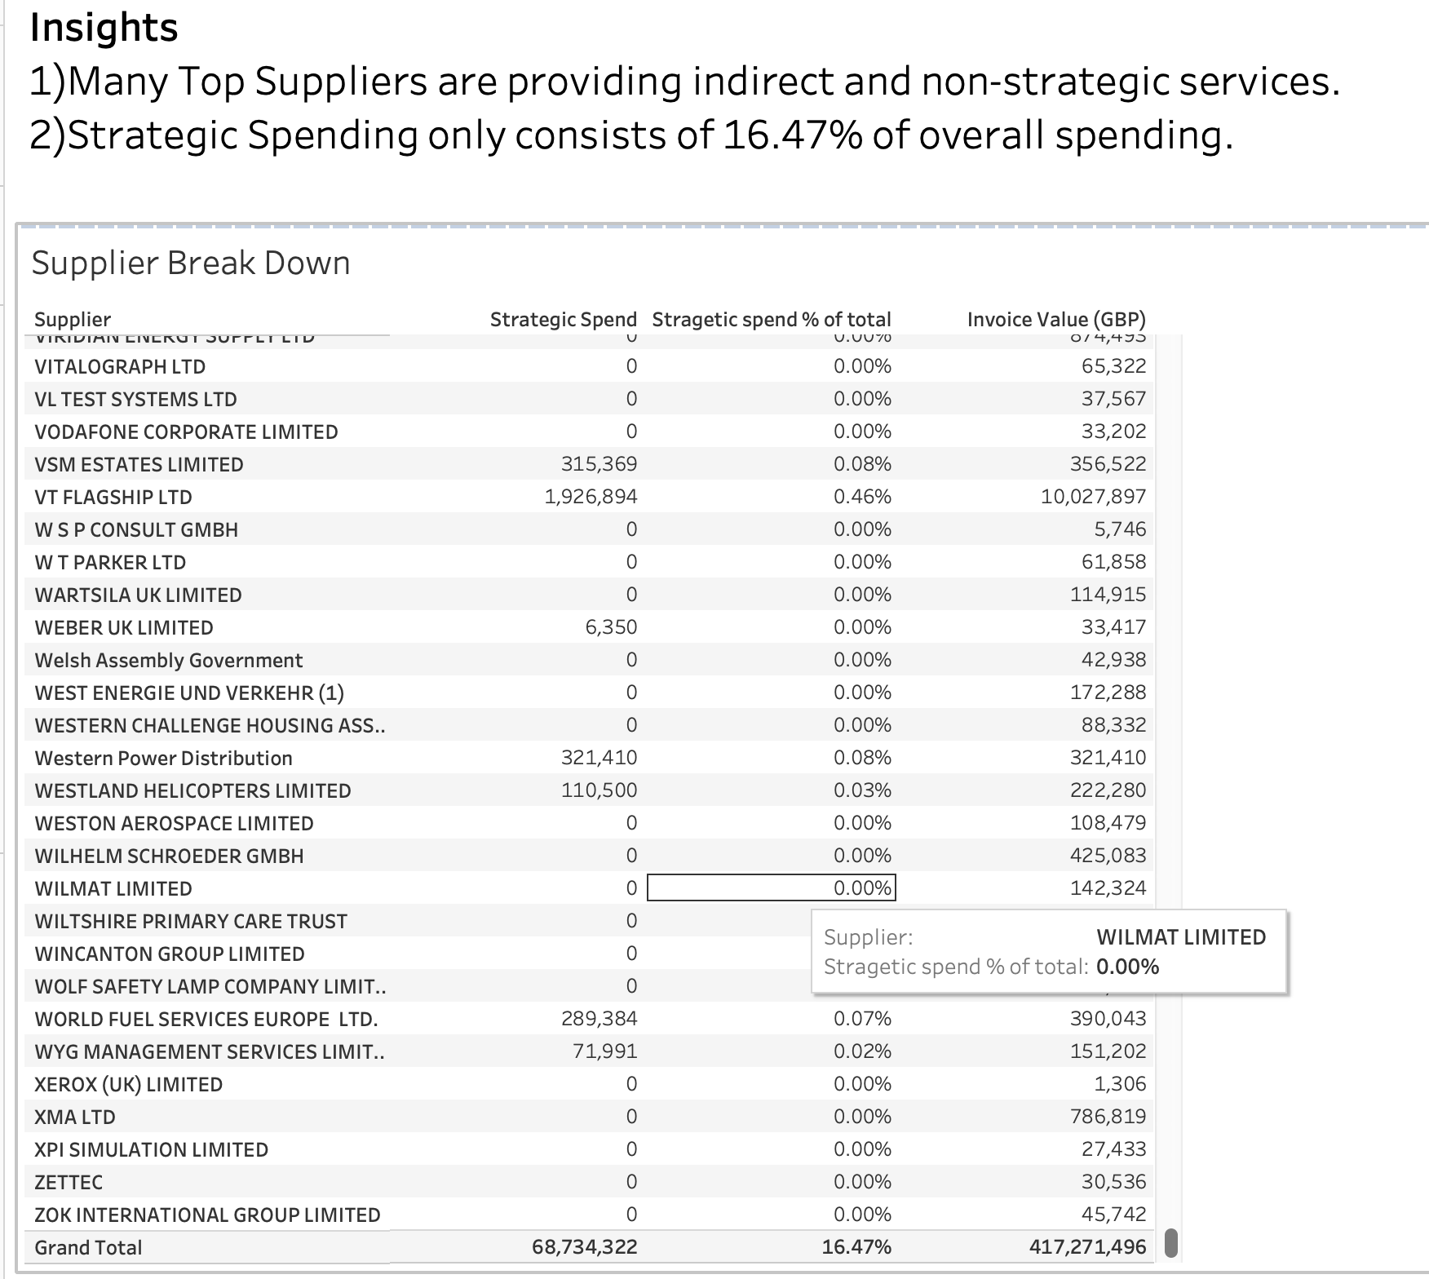

Slide 9
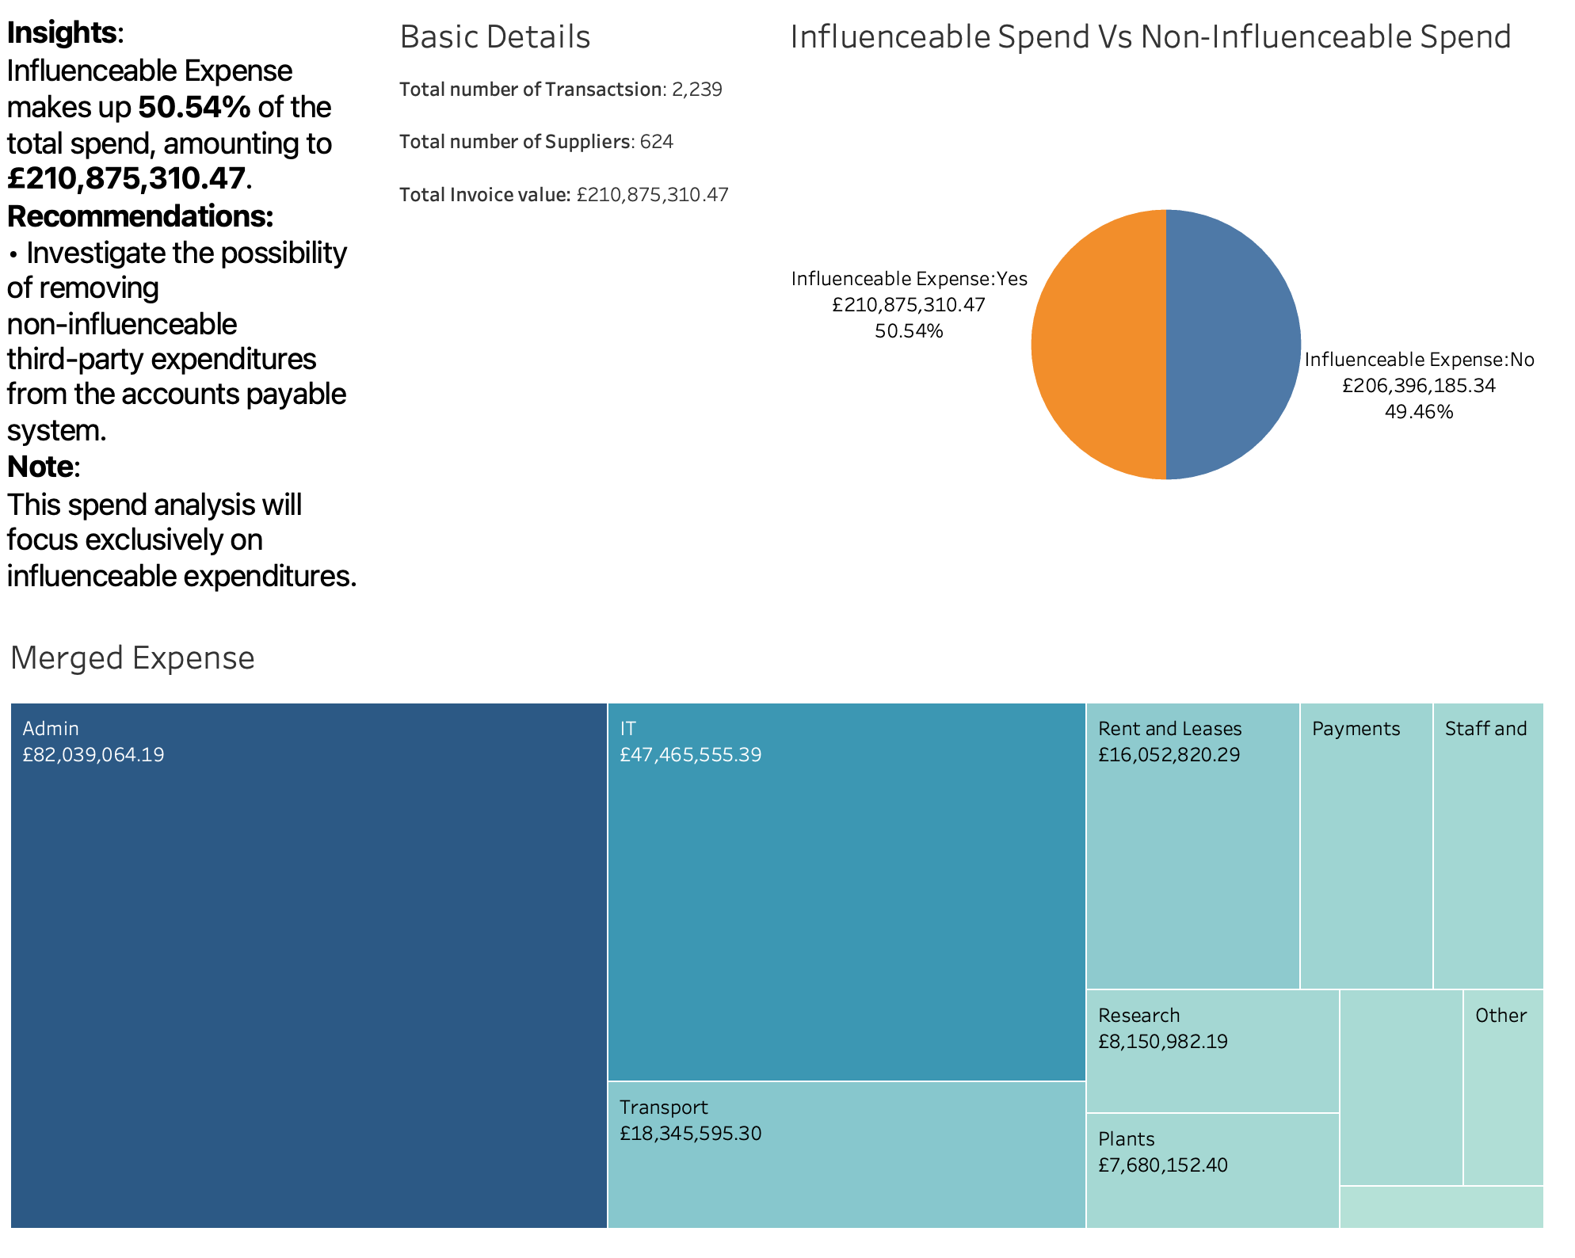
Spend Analytics(Influenceable spend)

Slide 10
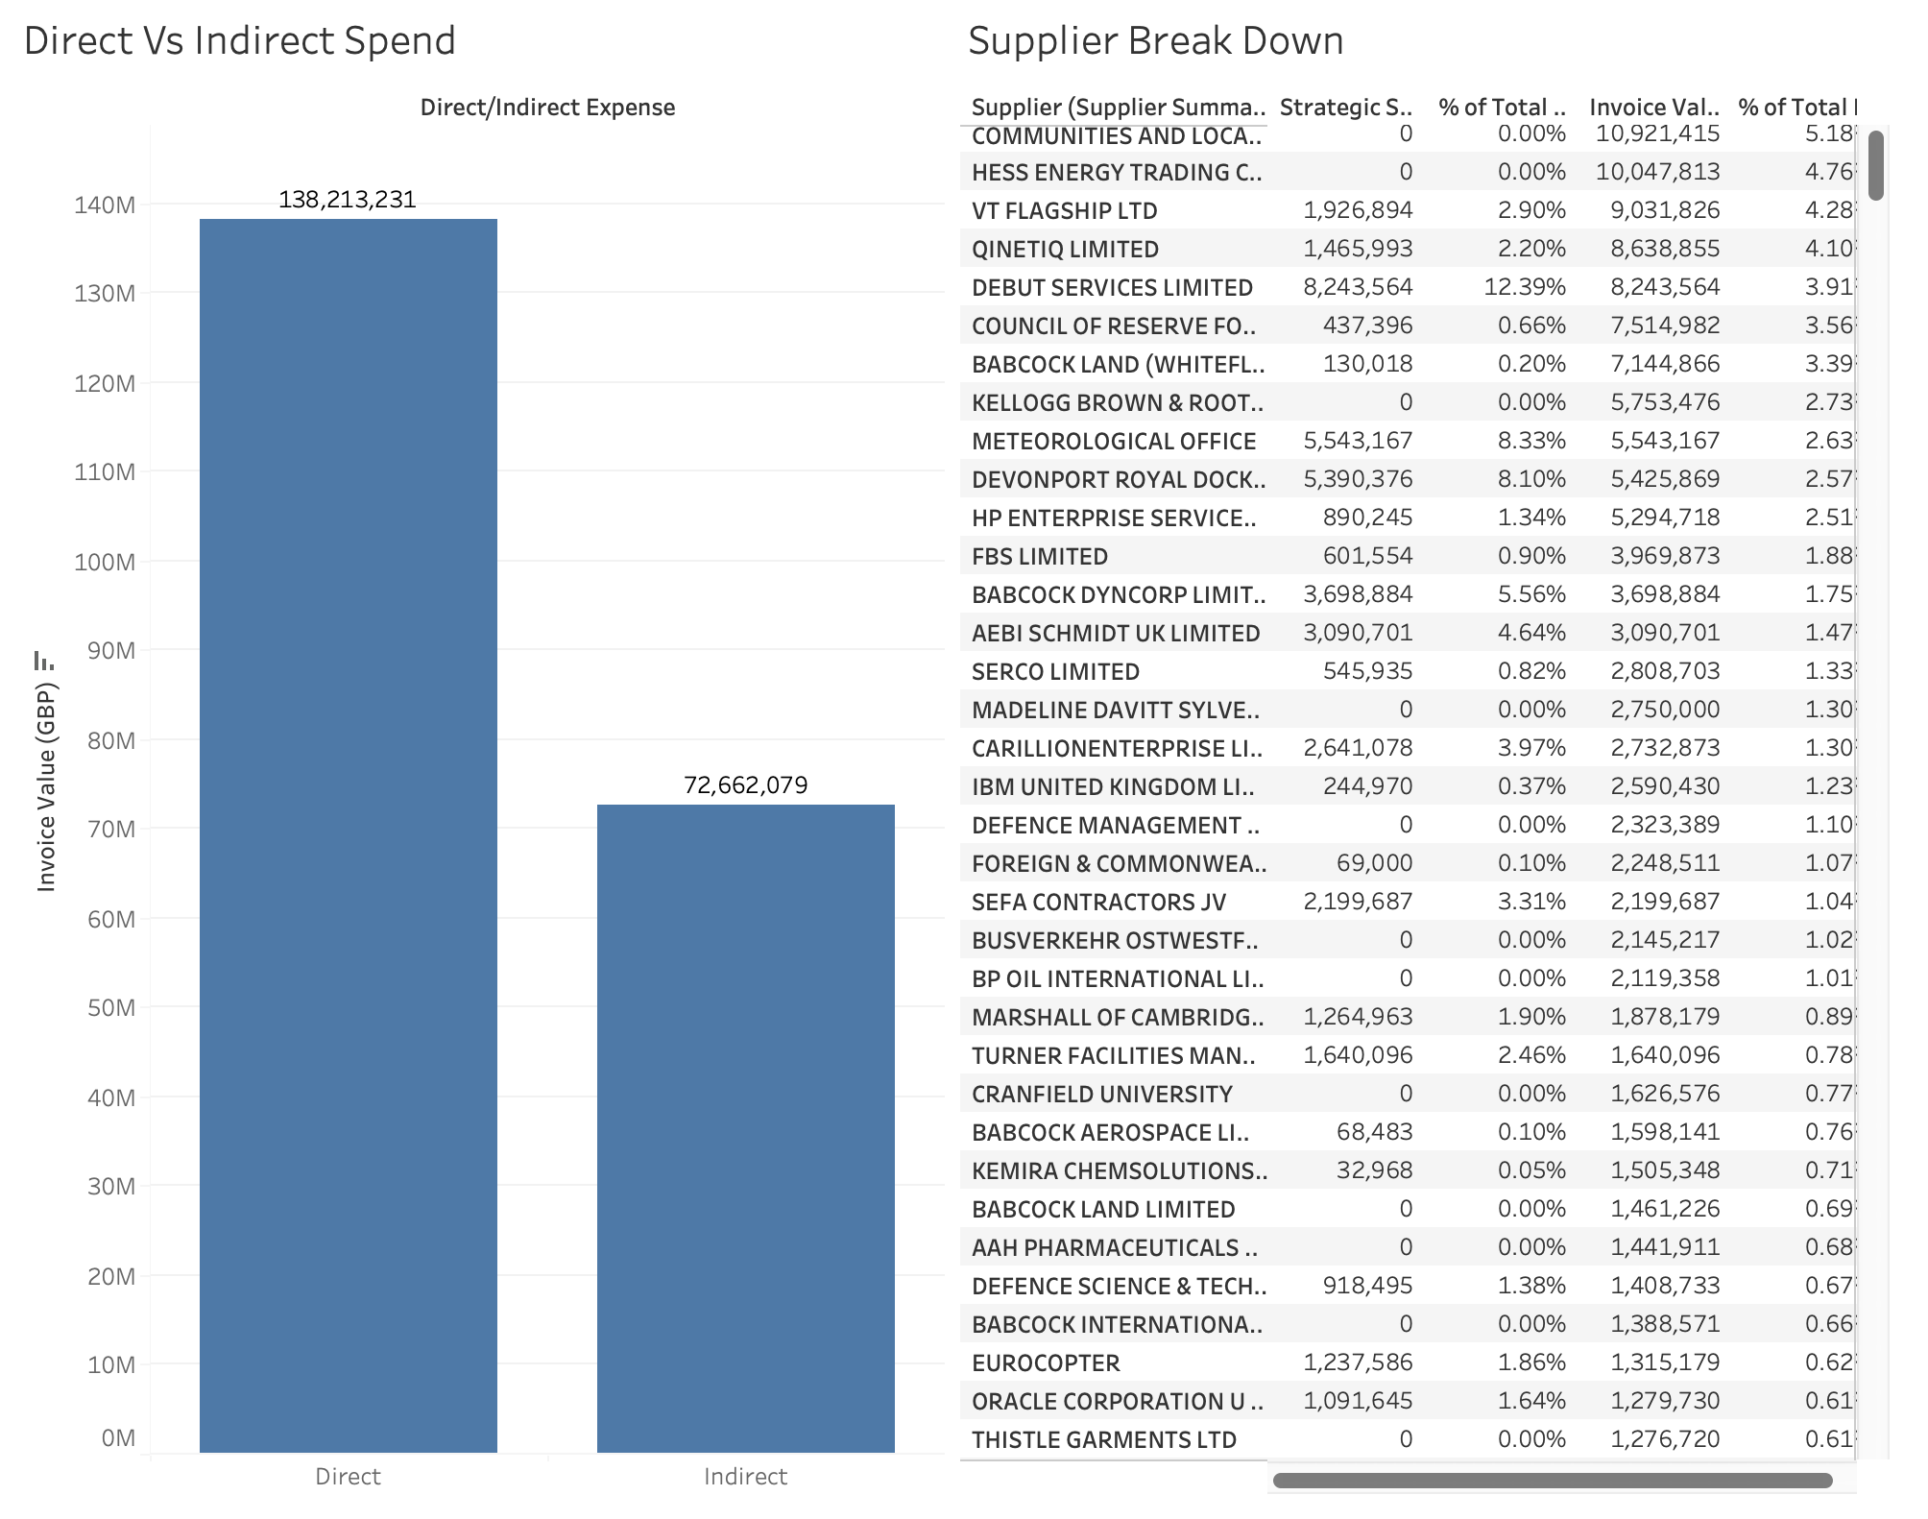

Slide 11
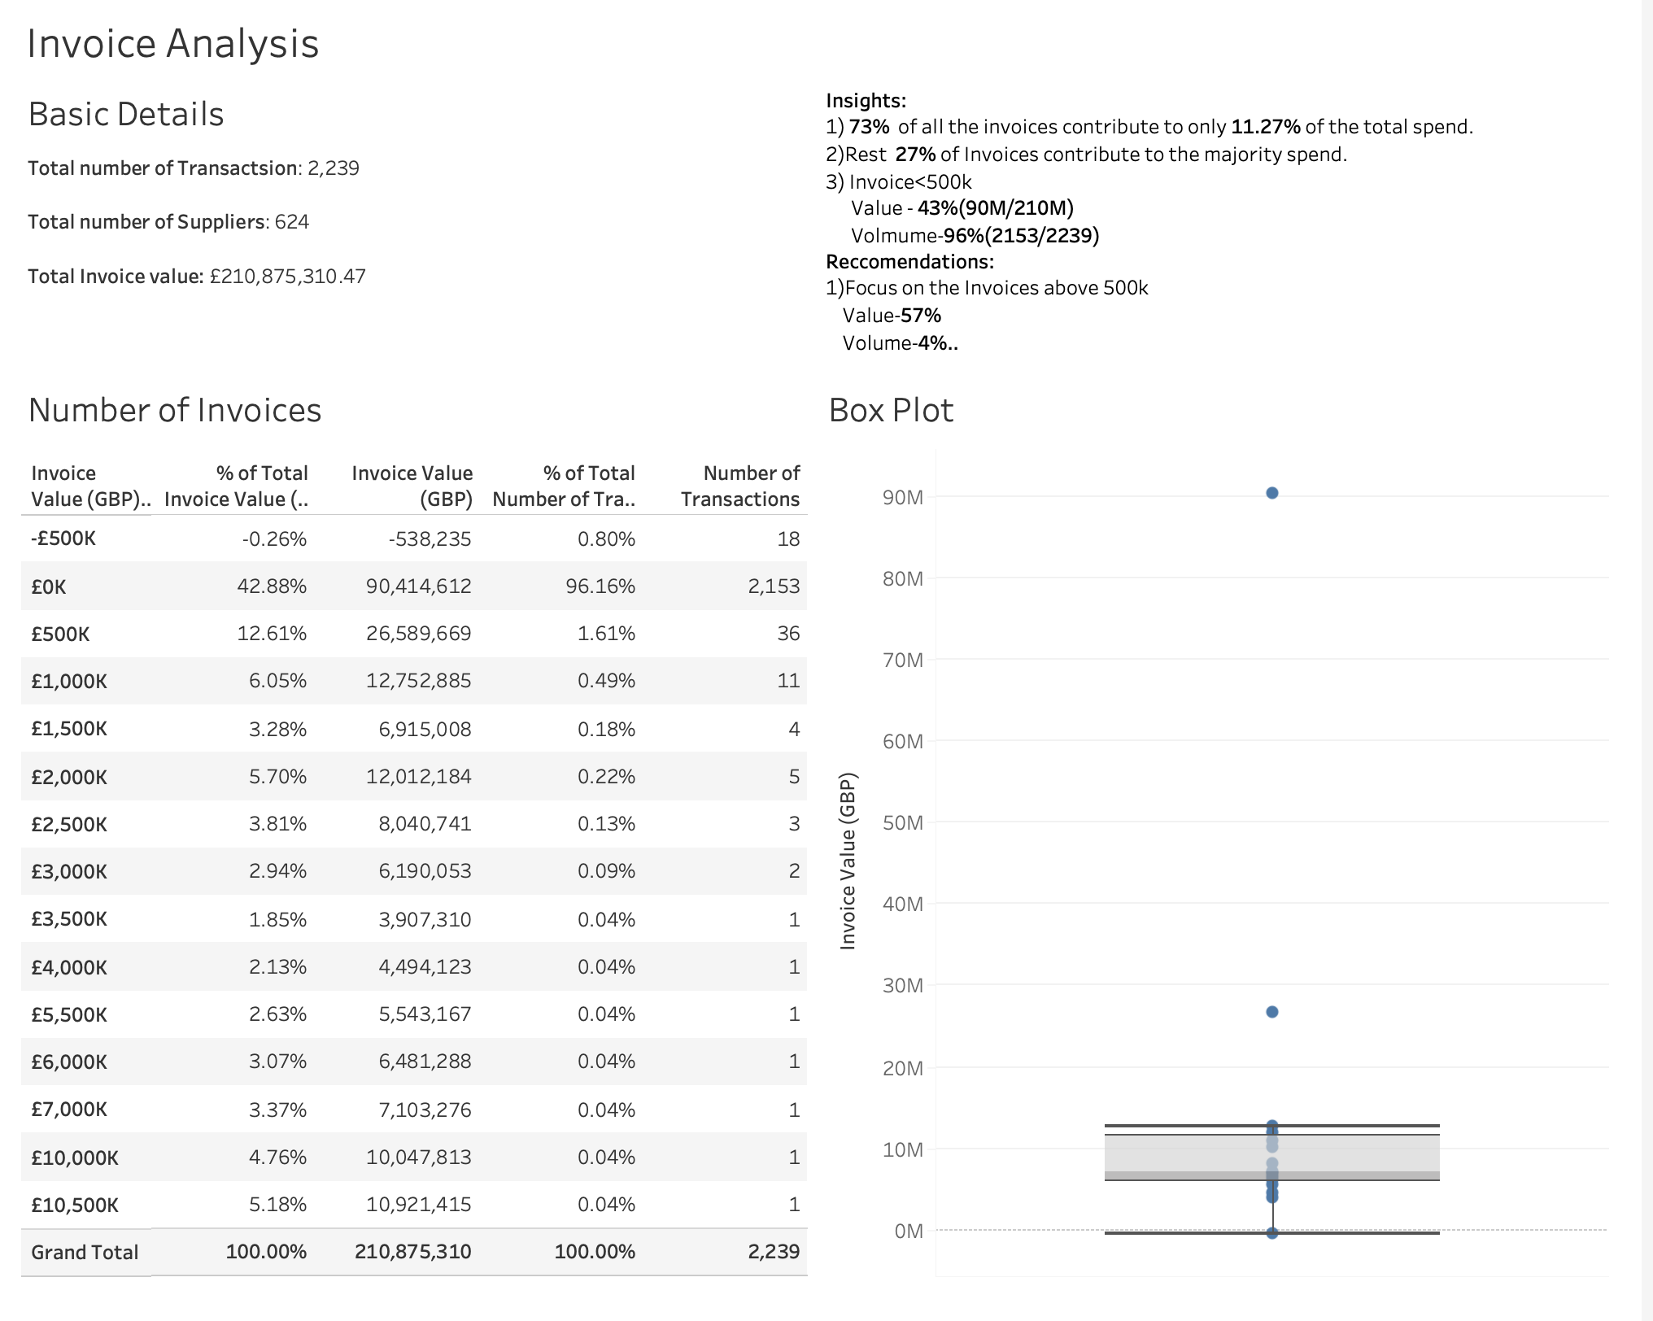
Invoice Analysis

Slide 12
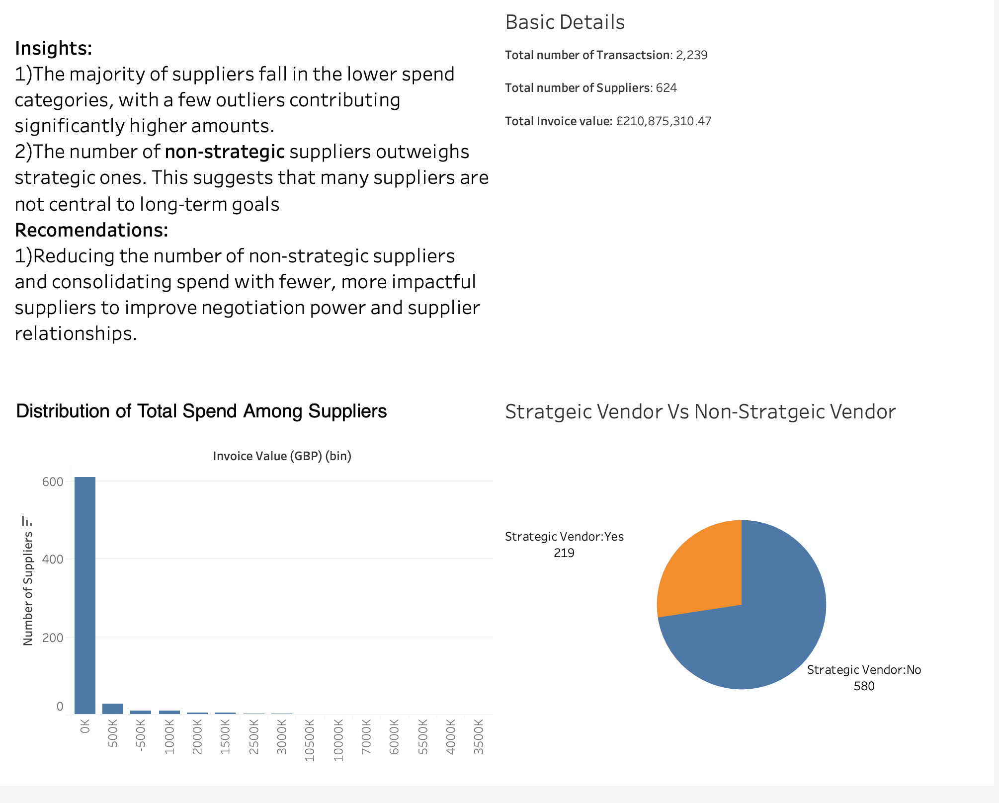
Supplier Analysis
Overview

Slide 13
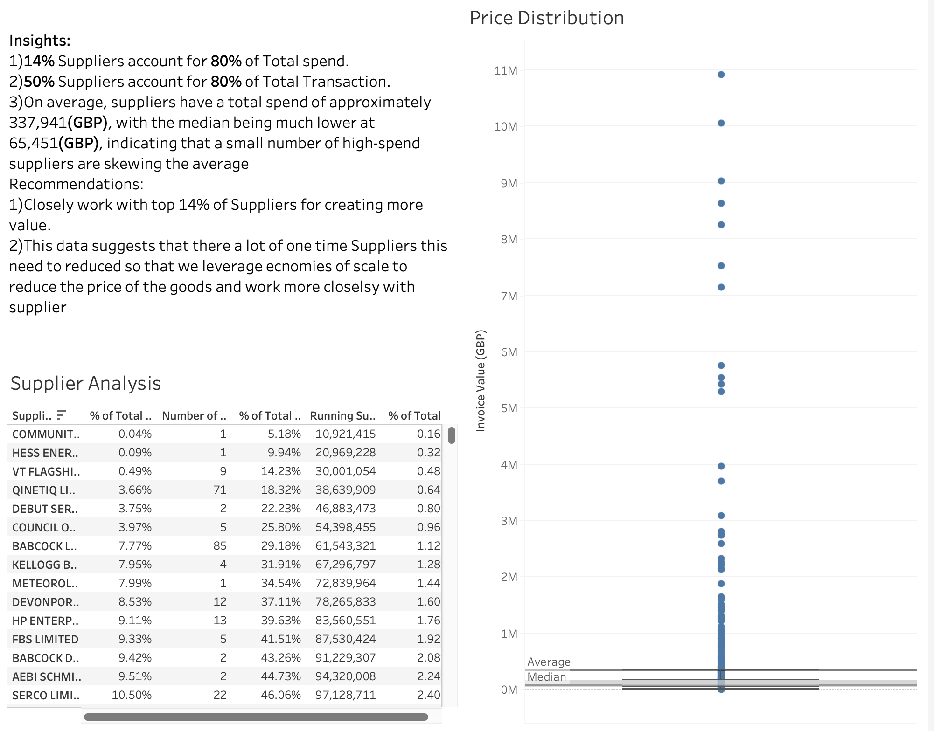

Slide 14
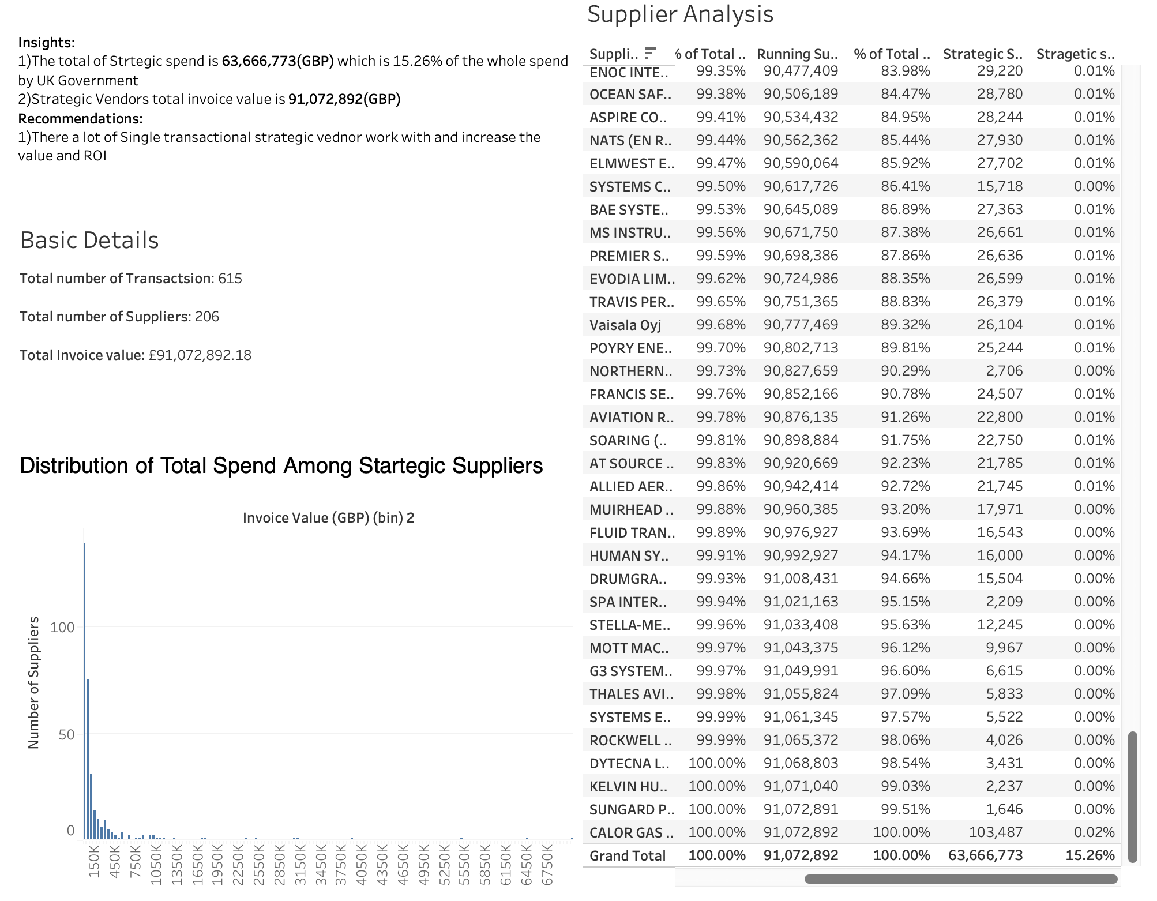
Supplier Analysis
Strategic vendors

Slide 15
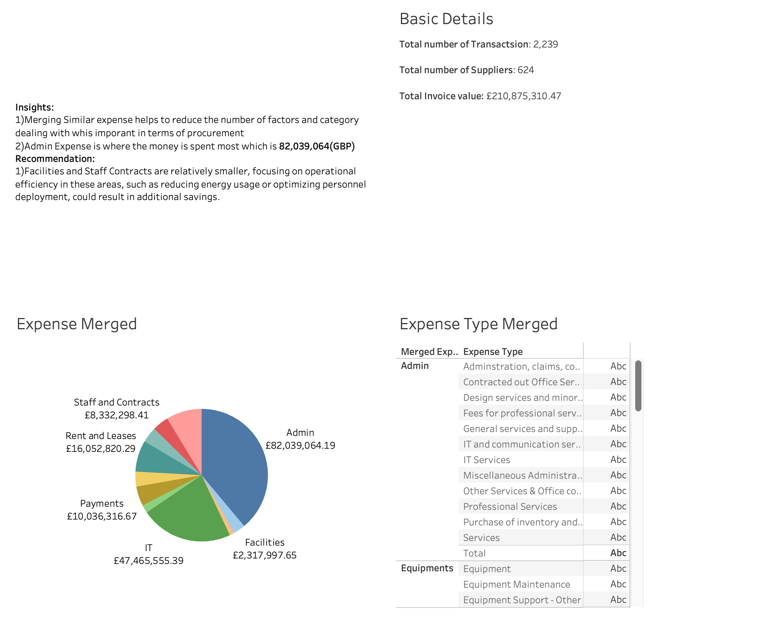
Expense Type Analysis

Slide 16

Risk and Risk Management in UK Defense(MOD):
Risk makes up a substantial part of the procurement activities in UK defence contracts, especially due to the magnitude of defence projects
Key Risks in UK Defence Procurement:
Financial Risks:
AAH PHARMACEUTICALS LTD, have a significantly higher total spend (over £1.4M). Over-reliance on a few high-spend suppliers increases vulnerability in case of supplier issues or financial instability. Financial Risk.
Suppliers marked as Strategic Vendors, such as ACCLIMATISE LIMITED, hold critical roles in operations.
Mitigation:
Spread procurement across multiple suppliers to reduce dependency on high-expenditure vendors like AAH PHARMACEUTICALS LTD.
Regularly review the performance and stability of strategic vendors such as ACCLIMATISE LIMITED.

Slide 17

Risk and Risk Management in UK Defense(MOD):
Operational Risk:
Suppliers such as SEFA CONTRACTORS JV (invoice value: £1,080,477.07) are critical for direct operational needs. Disruptions in their supply chain could lead to project delays or interruptions.
Some suppliers, like Equator Catering (invoice value: £32,740.50), may not be classified as strategic, but delays in their services could impact other operations.
Mitigation:
Supplier Contingency Plans: Create Partnerships with backup suppliers in order to satisfy such requirement if need arises
Inventory Buffering: Hold reserve certain critical items procured from critical suppliers who are strategically located

Slide 18

Risk and Risk Management in UK Defense(MOD):
Cybersecurity Risks:
Data Breach-Strategic suppliers like AAH PHARMACEUTICALS LTD (total spend: £1,441,911.02) handle critical healthcare procurement, and a data breach in their system could expose sensitive procurement data, including contract details, prices, and health-related supply chains.
Strategic suppliers like ABBOTT LABORATORIES LIMITED (total spend: £38,103.92) are involved in supplying critical medical equipment. Operations may be affected by complications or delays in the procurement process if their supply chain systems are compromised.
Mitigations:
Conduct annual cybersecurity audits for strategic vendors like AAH PHARMACEUTICALS LTD to ensure compliance with industry security standards.
Continuously assess the cybersecurity risks within the supply chains of strategic vendors like ABBOTT LABORATORIES. This includes evaluating how they manage third-party suppliers and their exposure to cyber risks.

Slide 19
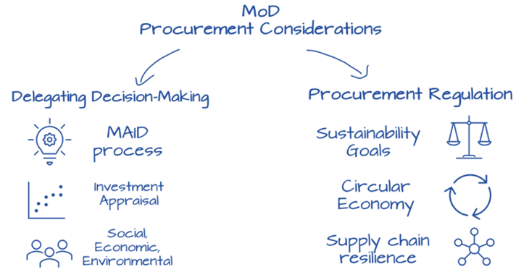
Key Insights
Top Suppliers are not diverse in Strategic Spend:
Despite the high influenceable spend with VT FLAGSHIP LTD and QINETIQ LIMITED, there would appear a lack of diversity within this strategic spend. It, therefore, follows that while the Ministry over-relies on a few suppliers, it hasn't integrated them appropriately for longer-term value creation.
Poor Utilization of Strategic Spend Opportunities:
Flagship Ltd. and Debut Services Ltd. have large influenceable spend with lower strategic investment. In other words, though they are operationally important, they are not being leveraged for strategic value, leaving cost savings and innovation opportunities on the table.
Vendor Spend Balance:
The percentage of the total spend that vendors like QINETIQ LIMITED and VT FLAGSHIP LTD consume reveals overdependence on one or a small group of vendors. This, of course, can result in some over-reliance on the same suppliers, leading to price power disadvantages, reduced negotiating flexibility, and making the organization taken by surprise if there is supply chain disruption

Slide 20
Key Insights
Blind Spots of Costs-Potential within Lower-Spending Vendors:
A set of vendors in the long tail-not represented within the top analysis-aren't strategic, Yet build up a small percentage of influenceable spend. Unless closely monitored these small spends could quietly add up to substantial unreconciled costs over a period of time.
Imbalance between Strategic vs. Tactical Sourcing:
This vendor strategy is one that seems to be tactically driven, with high influenceable expenses but lower emphasis on converting the vendors into strategic partners. This tends to reduce the full potential of driving innovation, efficiency improvement, and long-term sustainability in the supply chains.

Slide 21

Recommendations
Strategic Diversification and Supply Chain Resilience:
Dependency on strategic vendors, for instance QINETIQ LIMITED and VT FLAGSHIP LTD may be reduced by adding new vendors or also by dispersing the items to be procured among several small-scale suppliers. This would introduce some competition that would improve the scope for negotiation and bring additional supply chain resilience in case of disruptions.
Convert Tactical Vendors to Strategic Partners:
For those few vendors with high influenceable spend and low strategic engagement, discussions should be initiated with a view to moving them beyond a merely transactional supplier. This will include seeking opportunities for joint innovation, shared risk, and value-added services that create benefit for both the organization and the supplier.

Slide 22
Recommendations
Competitive Bidding and Vendor Benchmarking:
It is suggested to begin competitive comparisons for highly influential spend vendors, such as DEBUT SERVICES LIMITED, in order to optimize terms, service levels, and pricing. To maintain pressure on current suppliers, this might be accomplished by holding recurrent tenders or by seeking competitive bids from different vendors.
Long-Tail Vendor Consolidation:
Less critical suppliers are those vendors who accumulate smaller influenceable spends that are not part of the core strategic relationships. The goal is to consolidate vendors for smaller buys inorder to increase the organization's buying power, simplify the procurement process, and decrease the administrative overhead associated with it.

Slide 23

General Recommendations
Flexibility in Vendor Contracts:
Apply flexibility in the contracts of high-influenceable vendors inorder to make changes to the terms according to the market.This could entail a cost-sharing or based on performance system of rewards that enables dynamic cost adjustments, preventing the company from entering into unfavourable terms when market swings happen.
Strategic Spend Reallocation:
Rebalance the strategic spend by engaging those vendors representing low strategic spend with highly influenceable expenses. Use long-term contracts that include innovation, technology integration, or joint-efficiency programs to incentivize deeper collaboration with such suppliers.

Slide 24
Special Recommendations
Utilize technology to Track Spend:
This will make it possible for the Ministry to find cost-saving opportunities fast and take appropriate action before minor problems turn into major inefficiencies.
Cross-Departmental Vendor Utilization Review:
Involve various departments that use important vendors' services to see how their output fits with overarching objectives. This could point to new areas of reduction, better service delivery, or innovation opportunities.
Supplier development programs:
Invest in supplier development programs for those critical vendors with high influenceable but low strategic spend. This will help improve their operational efficiency and reduce their costs over time, which in turn will help the ministry benefit from those savings in the future.

